Slide 1
Biodiversity for the National Parks: Conservation Analysis
Capstone Project 2
04/05/2018

Slide 2
Objective
Reason for analysis:
The National Parks Service needed me to perform some data analysis on the conservation statuses of national park species, including plants, and to investigate if there are any patterns or themes to the types of species that become endangered. They also wanted me to discern where various sheep species were in the National Parks system. Finally, they wanted me to use this data to calculate how many weeks the rangers needed to observe these sheep in order to be sure that foot and mouth disease cases were dropping by more than 5 percent.
The main questions that they wanted me to answer was:
Are certain types of species more likely to be endangered?
What parks have sheep sightings and how many sightings are there?
Has foot and mouth disease dropped by more or less than 5 percent?

Slide 3
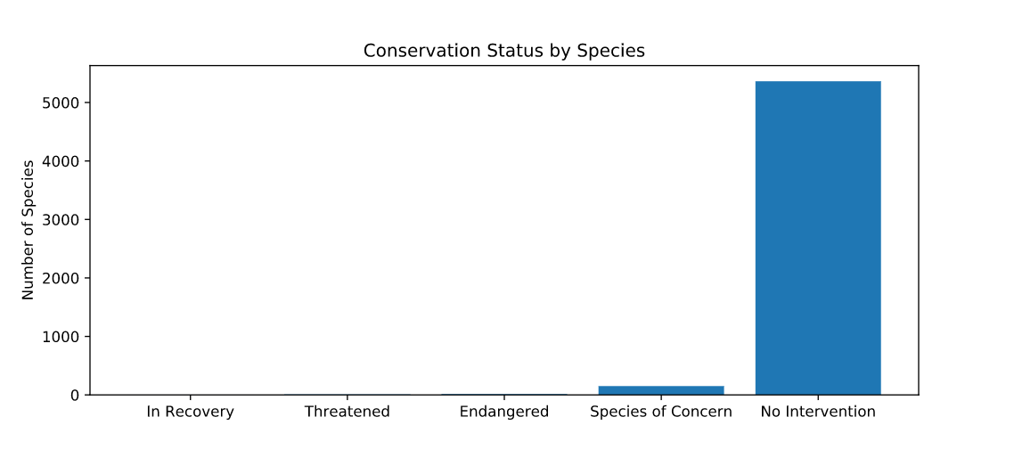
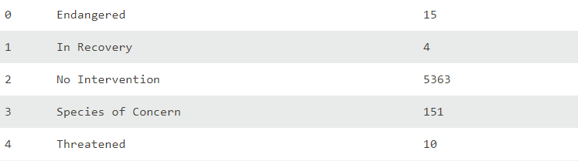
Observations from initial .csv data
The data was separated into the following columns; category(species type), scientific name, common name, and conservation status
The species count (rows) were 5541 unique values. The initial result returned much less values than this number so I had to calculate the null values and chart them
Once the null values were calculated, I could move on to analyzing the data to determine whether or not certain types of species are more likely to be endangered

Slide 4
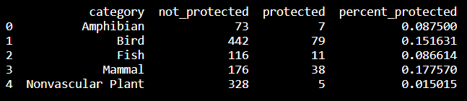
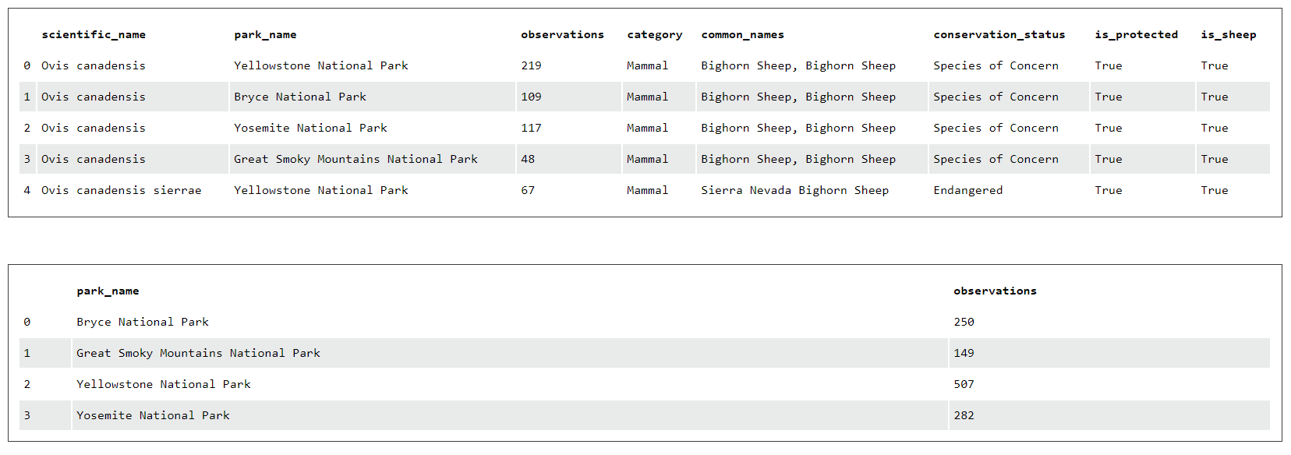
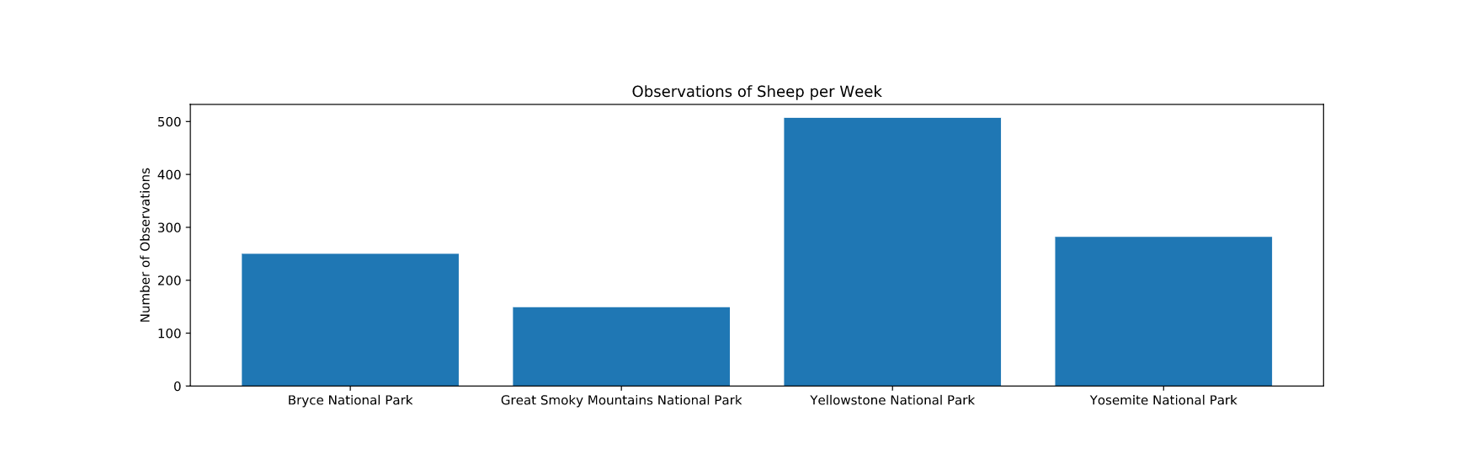
Results from Statistical Analysis
I performed a significance test to test the null hypothesis of whether or not Mammals were more likely to be endangered than birds. After creating a contingency table and performing a chi-test, the p-value returned was greater than 5% so there was no significance between Mammals and birds being endangered. However, after testing between Mammals and reptiles, the p-value returned was less than 5%, meaning that there was a significance across certain species
Then, I created a dataframe to count the observations of sheep. The initial dataframe contained plants but after I removed them, the result was a correct dataframe
Finally, I plotted a bar graph of the data. Then I used this data to calculate the sample size needed per variant which returned as 870. This number, divided by the observation number by park returned the number of weeks needed to be spent observing per park. This was 1.716 weeks for Yellowstone and 3.48 weeks for Bryce Canyon

Slide 5
Recommendation
Yes, certain species are more likely to be endangered
There are sheep sightings in Bryce, Great Smoky Mountains, Yellowstone and Yosemite National Parks. With 250, 149, 507 and 282 sightings respectively
Using this data with a baseline of 15% foot and mouth disease observed, scientists will need to spend 1.716 weeks in Yellowstone and 3.48 weeks in Bryce in order to be sure that foot and mouth disease was decreasing by 5%

Slide 6
Thank You

